Slide 1
Project Flight Price Prediction
Submitted By:
Kirti Ohlan

Slide 2
Business Problem Framing
Airline companies use complex algorithms to calculate flight prices given various conditions present at that particular time. These methods take financial, marketing, and various social factors into account to predict flight prices.
Nowadays, the number of people using flights has increased significantly. It is difficult for airlines to maintain prices since prices change dynamically due to different conditions. That’s why we will try to use machine learning to solve this problem. This can help airlines by predicting what prices they can maintain. It can also help customers to predict future flight prices and plan their journey accordingly.

Slide 3
Proposed Framework
Our suggested approach makes use of datasets to forecast airfare at the business segment levels. Fig 2 depicts a high-level view of the project framework's primary components. During the data pre-treatment stage, all databases are cleaned to remove any potentially erroneous examples, then converted and integrated depending on market group. The feature extractor extracts and generates handmade attributes that are intended to describe the segment of the market. The goal of adaptive filtering modules is to improve accurate channels by assessing the utility of the characteristics and removing any unnecessary characteristics. Finally, we use the selected criteria to build our forecasting techniques, that result in the finished product of the projected airline cost of the ticket.

Slide 4
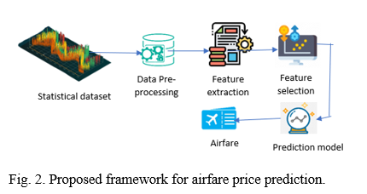

Slide 5
Data Preprocessing
Data pre-processing in Machine Learning refers to the technique of preparing (cleaning and organizing) the raw data to make it suitable for a building and training Machine Learning models. In other words, whenever the data is gathered from different sources it is collected in raw format which is not feasible for the analysis. Data pre-processing is an integral step in Machine Learning as the quality of data and the useful information that can be derived from it directly affects the ability of our model to learn; therefore, it is extremely important that we pre- process our data before feeding it into our model. Therefore, it is the first and crucial step while creating a machine learning model. I have used some following pre-processing steps:

Slide 6
Creating the dataset as a DataFrame.
Used pandas to set display I ensuring we do not see any truncated information.
Checked the number of rows and columns present in our training dataset.
Checked for missing data and the number of rows with null values
Duplicate values are also present in our dataset.
Checked the unique values information in each column to get a list for categorical data
Used Pandas Profiling during the visualization phase along with violin plot, count plot, cat plot and the others
With the help of ordinal encoding technique converted all object datatype columns to numeric datatype
Thoroughly checked for outliers and skewness information
With the help of heatmap, correlation bar graph was able to understand the Feature vs Label relativity and insights on multicollinearity amongst the feature columns
Separate feature and label data to ensure feature scaling is performed avoiding any kind of biasness
Checked for the best random state to be used for our Regression Machine Learning model pertaining to the feature importance details
Finally created a regression model function along with evaluation metrics to pass through various model formats

Slide 7
Algorithms
Linear Regression Model
Ridge Regularization Regression Model
Support Vector Regression Model
Decision Tree Regression Model
Random Forest Regression Model
K Nearest Neighbours Regression Model

Slide 8
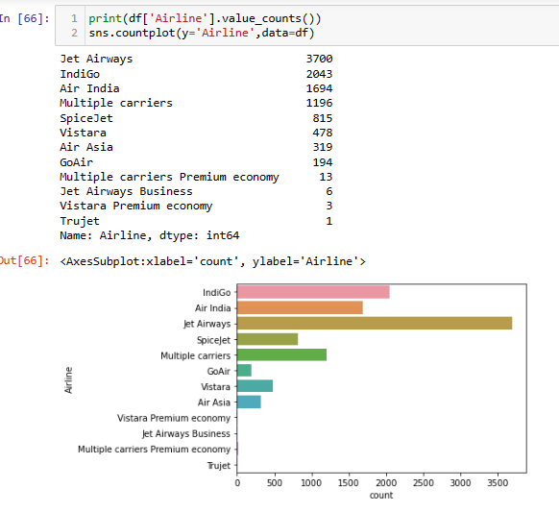
Visualize the airline

Slide 9
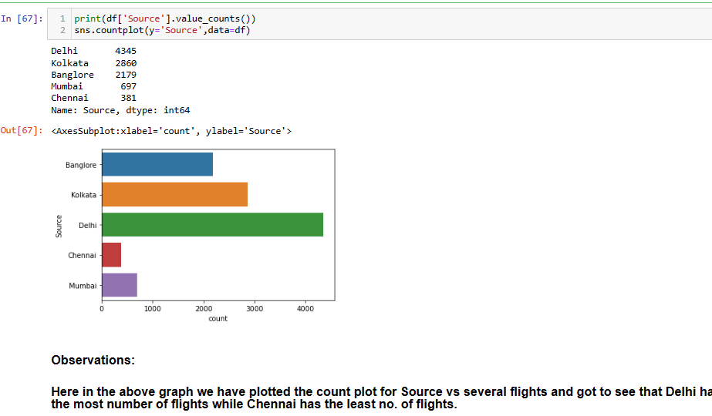
Visualize the source

Slide 10
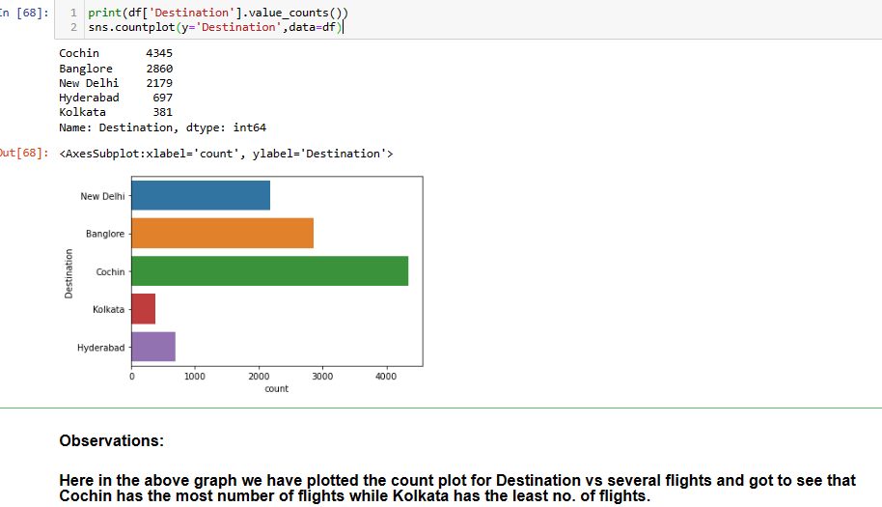
Visualize the Destination

Slide 11
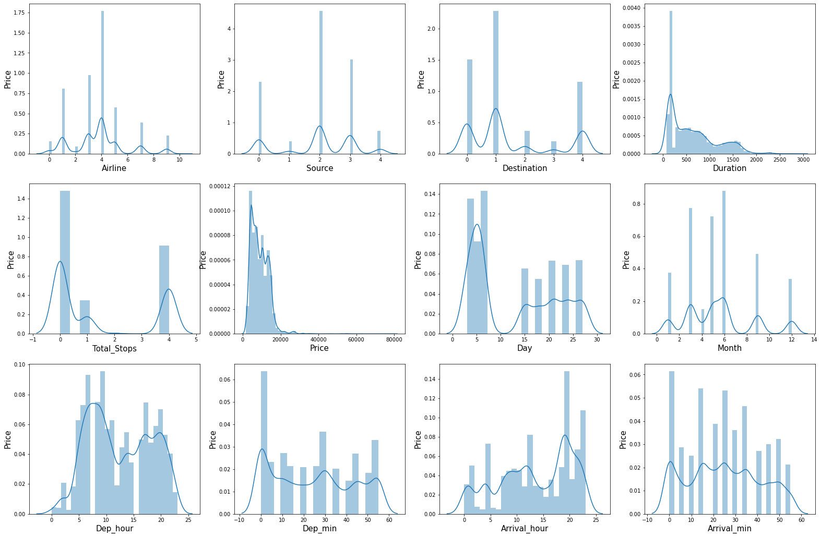
Distribution plot

Slide 12
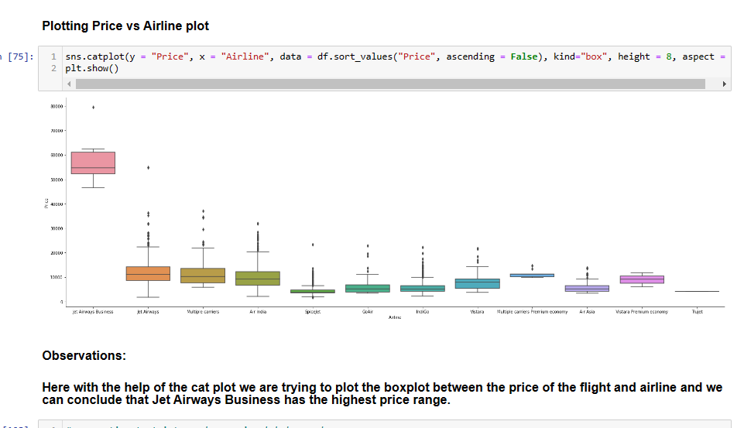

Slide 13
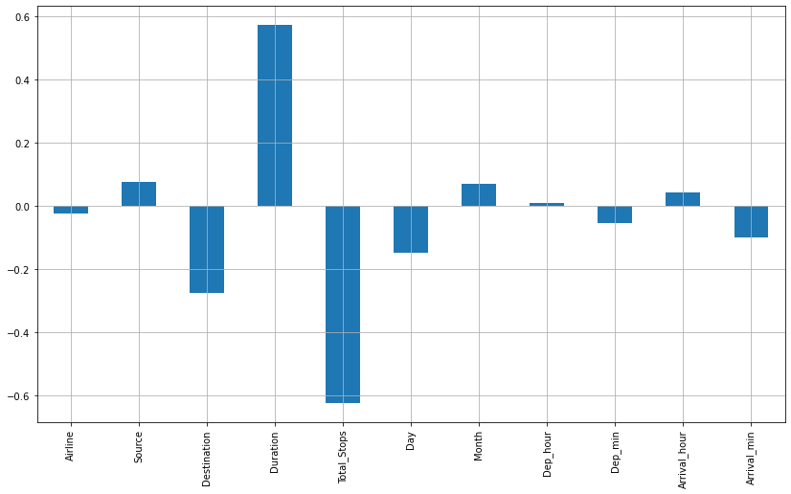
Correlation

Slide 14
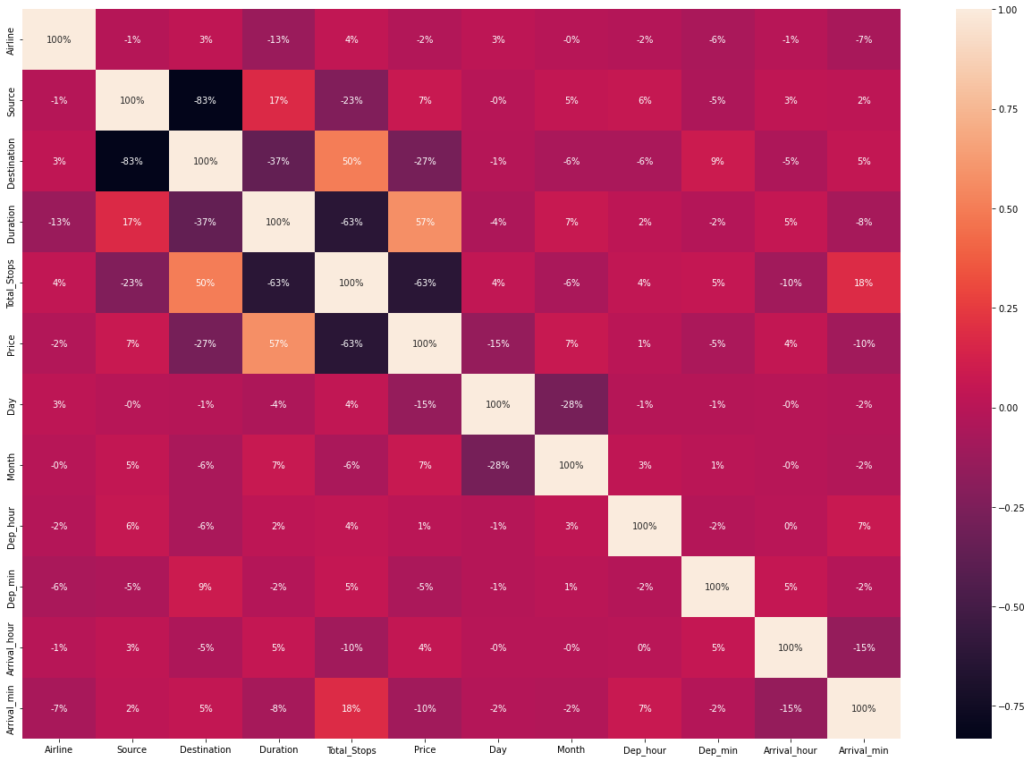
Heatmap

Slide 15
Conclusion
Five machine learning models were examined in this case study to forecast the average flight price at the business segment level. We used training data to train the training data and test data to test it. These records were used to extract a number of characteristics. Our suggested model can estimate the quarterly average flight price using attribute selection strategies. To the highest possible standard, much prior studies into flight price prediction using the large dataset depended on standard statistical approaches, which have their own limitations in terms of underlying issue estimates and hypotheses. To our knowledge, no other research have included statistics from holidays, celebrations, stock market price fluctuations, depression, fuel price, and socioeconomic information to estimate the air transport market sector; nonetheless, there are numerous restrictions. As example, neither of the databases provide precise information about ticket revenue, including such departing and arrival times and days of the week. This framework may be expanded in the future to also include airline tickets payment details, that can offer more detail about each area, such as timestamp of entry and exit, seat placement, covered auxiliary items, and so on. By merging such data, it is feasible to create a more robust and complete daily and even daily flight price forecast model. Furthermore, a huge surge of big commuters triggered by some unique events might alter flight costs in a market sector. Thus, incident data will be gathered from a variety of sources, including social media sites and media organizations, to supplement our forecasting models. We will also examine specific technological Models, such as Deeper Learning methods, meanwhile striving to enhance existing models by modifying their hyper-parameters to get the optimum design for airline price prediction.

